Slide 1

Laboratory & Professional skills for Bioscientists Term 2: Data Analysis in R
Week 4: Chi-squared tests

Slide 2
Overview of topics
Week | Topic
2 | Introduction to module, statistics and RStudio including first figure
3 | Hypothesis testing, variable types; functions (inbuilt ), different ways of getting data into RStudio, getting help in RStudio
4 | Chi-squared tests
5 | The normal distribution, summary statistics and confidence intervals; user-defined functions, RStudio
6 and 7 | One- and two-sample t-tests and their non-parametric equivalents (2 lectures)
8 | One-way ANOVA and Kruskal-Wallis
9 | Two-way ANOVA incl understanding the interaction
10 | Correlation and regression

Slide 3
Follow up from last week’s practical
Independent study: seal myoglobin exercise at the end of this lecture…
But first………

Slide 4
Summary of this week
We start significance testing
We will introduce the analysis of counts of things falling into mutually exclusive categories using two types of chi-squared test

Slide 5
Learning objectives for the week
By actively following the lecture and practical and carrying out the independent study the successful student will be able to:
recognise when to use chi-squared Goodness of Fit and Contingency tests (MLO 2)
be able to carry out, interpret and report scientifically both types of test in R (MLO 3 and 4)

Slide 6
Why chi-squared?
When we count the number of things in categories and compare the numbers we observe to numbers we expect under a null hypothesis.
H₀ might expect numbers to
be the same, or
follow a particular pattern, or
match the pattern in another group
Chi-squared allows us to make the comparison statistically

Slide 7
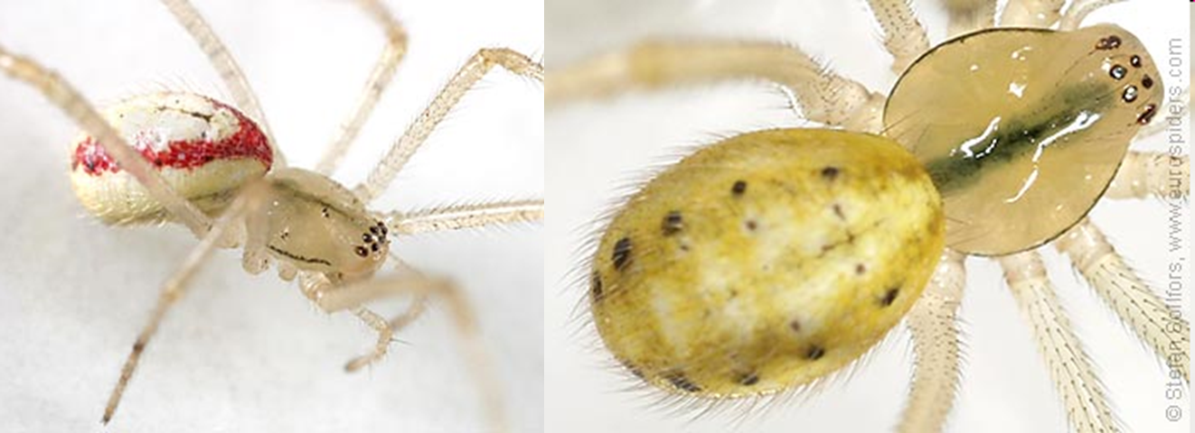
Our two example scenarios
The Candy-striped spider can be plain or striped
2 alleles at one locus, striped dominant to plain
We perform: Ss x ss = Ss, Ss, ss,ss
We expect the ratio of striped : plain to be 1:1

Slide 8
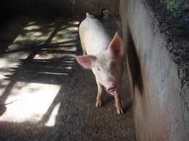
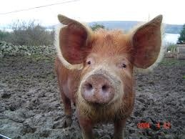
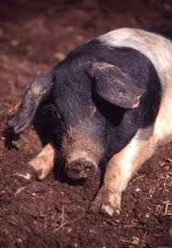



Example scenarios
Food choice by pig breeds
We don’t know what proportions are expected but do expect it to be same for each breed
Welsh Tamworth Essex
cabbage
sugarbeet
swede

Slide 9
Two types of scenario thus two types of χ² test
We know what the proportions should be (known as a priori expectations)
Goodness of fit (e.g., candy striped spiders)
We don’t know what the proportions should be (without a priori expectations) but we know they should be the same in each group
Contingency (e.g., pigs and food)

Slide 10
The Chi-squared formula
O – observed number
E – expected numbers
Σ – take the sum of

Slide 11
The Chi-squared formula
The difference between what we see and what we expect to see if H₀ is true
…squared so positive
……..relative to expected value
Gets bigger as the difference increases.
Also as number of categories increase therefore d.f. matter

Slide 12
χ² Goodness of fit test
The expected values (null hypothesis) are derived from some theory
We test the fit of our data to the theory
The ‘theory’ can be a uniform distribution
In our first example the theory is Mendel’s Law (and happens to be uniform too)

Slide 13

χ² Goodness of fit test: example
The Candy-striped spider: Striped : plain is 1:1
63 offspring
Observed | 28 | 35
Expected | 31.5 | 31.5

Slide 14
χ² Goodness of fit test: example
At least two ways to conduct in R.
By coding the formula
By using the inbuilt function
We’ll do both; you can use either.

Slide 15

χ² Goodness of fit test: example
By coding the formula
Observed values
Observed | 28 | 35
expected | 31.5 | 31.5
##################################################
# CHI-SQUARED BY CODING THE FORMULA #
##################################################
# the observed data
obs <- c(28, 35)
# total number of observations
total <- sum(obs)

Slide 16
χ² Goodness of fit test: example
By coding the formula
Expected values
Observed | 28 | 35
expected | 31.5 | 31.5
# calculated the expected values
# the H0 is for a 1:1 ratio
# i.e., half the total in each
exp <- c(total / length(obs), total / length(obs))
# I've used length(obs) rather than 2
# because it makes the code more reusable

Slide 17
χ² Goodness of fit test: example
By coding the formula
Code the formula
Observed | 28 | 35
expected | 31.5 | 31.5
# code the formula
chi <- sum(((obs - exp)^2) / exp)
# [1] 0.7777778

Slide 18
χ² Goodness of fit test: example
By coding the formula
Find the probability of getting a χ² of 0.778 or more extreme (bigger)
Observed | 28 | 35
expected | 31.5 | 31.5
# look up the probability of getting a chi squared
# of 0.778 or more extreme (bigger)
#
# the degrees of freedom are the number of
# categories minus 1
df <- length(obs) - 1
pchisq(chi, df = df, lower.tail = FALSE)
# [1] 0.3778216

Slide 19
χ² Goodness of fit test: example Conclusion
χ² = 0.78; d.f. = 1; p = 0.38
p > 0.05, therefore the test is not significant
Results are consistent with a 1:1 ratio
“There was no significant difference between the observed and the expected ratio.”

Slide 20
χ² Goodness of fit test: example Conclusion
IF you had χ² = 4.6; d.f. = 1; p = 0.032
p < 0.05 therefore the test is significant
Results are NOT consistent with a 1:1 ratio
“There was a significant difference between the observed and expected ratio (χ² = 4.6; d.f. = 1; p = 0.032).”
“There were significantly more xxxx and fewer xxxx than expected (χ² = 4.6; d.f. = 1; p = 0.032).” includes direction

Slide 21
χ² Goodness of fit test: example
By using the inbuilt function
Observed | 28 | 35
expected | 31.5 | 31.5
##################################################
# CHI-SQUARED BY CODING THE FORMULA #
##################################################
# we can use the same obs vector
chisq.test(obs)
# Chi-squared test for given probabilities
#
# data: obs
# X-squared = 0.77778, df = 1, p-value = 0.3778

Slide 22
χ² Goodness of fit test: example
But what to use?? What you prefer but….
By coding the formula
Useful when your expected are derived from a more complex theory/idea (e.g., poisson distribution, binomial distribution) or you need to alter the d.f.
By using the inbuilt function
Easy when the ratio is 1:1, 1:1:1, 1:1:1 etc
But take care – other H₀ must be specified

Slide 23



χ² Contingency test
Food choice by pig breeds
We don’t know what proportions are expected but do expect it to be same for each breed
Null hypothesis: proportion of foods taken by each breed is the same, i.e., no association between breed and food type
Welsh Tamworth Essex
cabbage
sugarbeet
swede

Slide 24
χ² Contingency test: example The Data
Welsh Tamworth Essex
cabbage
sugarbeet
swede
11 | 19 | 22 | 52
21 | 16 | 8 | 44
7 | 12 | 11 | 30
39 | 47 | 41 | 127
Expected values are derived from the data
Overall pref for cabbage = 52/127
We expect (the H₀)same for each breed

Slide 25
χ² Contingency test example Where do the expected values come from?
Welsh Tamworth Essex
cabbage
sugarbeet
swede
11 | 19 | 22 | 52
21 | 16 | 8 | 44
7 | 12 | 11 | 30
38 | 47 | 41 | 127
Overall preference for cabbage = 45/127
Thus: Exp no. of welsh preferring cabbage = 52/127 * 38 = 15.97
Exp no. of tamworth preferring cabbage 52/127 * 47 =19.24
Exp no. of essex preferring cabbage 52/127 * 41 = 16.79
RULE: Expected number for each cell:
Row total * Column total / Overall total

Slide 26

χ² Contingency test example Where do the expected values come from?
Wow, that’s a pain!
R to the rescue!
@allison_horst

Slide 27
χ² Contingency test example
R’s inbuilt function will do that!
First, add the data
# create the data
food_pref <- matrix(c(11, 19, 22,
21, 16, 8,
7, 12, 11),
nrow = 3)
# [,1] [,2] [,3]
# [1,] 11 21 7
# [2,] 19 16 12
# [3,] 22 8 11
Note: this is the only time we’ll use a matrix datatype – we normally use dataframes.

Slide 28
χ² Contingency test example
It’s helpful to name the rows and columns
# make a list object to hold two vectors
# a list is useful because the vectors can be
# of different lengths
vars <- list(breed = c("welsh",
"tamworth",
“essex"),
food = c("cabbage",
"sugarbeet",
"swede"))
food_pref <- matrix(c(11, 19, 22,
21, 16, 8,
7, 12, 11),
nrow = 3,
dimnames = vars)
And this is partly why! Dataframes always have named columns.

Slide 29
χ² Contingency test example
Now we have…
# food
# breed cabbage sugarbeet swede
# welsh 11 21 7
# tamworth 19 16 12
# essex 22 8 11
Run the inbuilt test
chisq.test(food_pref)
# Pearson's Chi-squared test
#
# data: food_pref
# X-squared = 10.64, df = 4, p-value = 0.03092

Slide 30
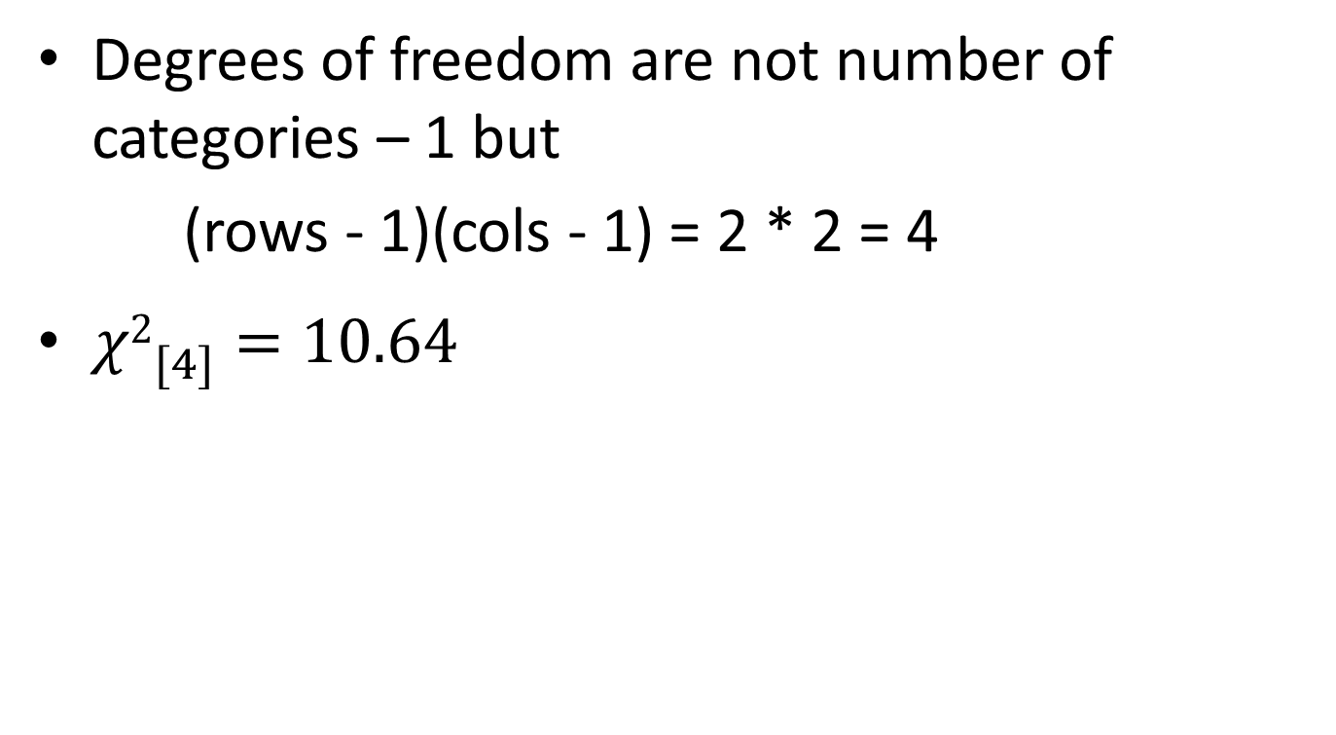
χ² Contingency test: example degrees of freedom
Degrees of freedom are not number of categories – 1 but
(rows - 1)(cols - 1) = 2 * 2 = 4
${χ2}_{[4]}^{}=10.64$

Slide 31
χ² Contingency test Conclusion
Thus the test is significant (we reject the null hypothesis)
Conclude: evidence of a preference for particular foods by different breeds
But in what way? (“direction of effect”)
Who likes what?

Slide 32
χ² Contingency test Conclusion
In what way – examine the observed and expected values.
Observed:
# food
# breed cabbage sugarbeet swede
# welsh 11 21 7
# tamworth 19 16 12
# essex 22 8 11
Expected:
chisq.test(food_pref)$expected
# food
# breed cabbage sugarbeet swede
# welsh 14.47619 13.87302 9.650794
# tamworth 17.90476 17.15873 11.936508
# essex 15.61905 14.96825 10.412698

Slide 33
χ² Contingency test Conclusion
Higher than expected
Less than 1 different
Lower than expected
Direction of deviations; size of deviation
Observed:
# food
# breed cabbage sugarbeet swede
# welsh 11 21 7
# tamworth 19 16 12
# essex 22 8 11
Expected:
chisq.test(food_pref)$expected
# food
# breed cabbage sugarbeet swede
# welsh 14.47619 13.87302 9.650794
# tamworth 17.90476 17.15873 11.936508
# essex 15.61905 14.96825 10.412698

Slide 34
χ² Contingency test Conclusion
Different pig breeds showed a significant preference for the different food types (χ² = 10.64; d.f. = 4; p = 0.031) with Essex much preferring cabbage and disliking sugarbeet, Tamworth showing a small preference for Cabbage and Welsh showing a strong preferencing for sugarbeet.
# food
# breed cabbage sugarbeet swede
# welsh 11 21 7
# tamworth 19 16 12
# essex 22 8 11

Slide 35
Summary
Two types of scenario thus two types of χ² test
Goodness of fit
We know what the proportions should be (known as a priori expectations); fit to a theory or distribution
Single row/column of observations. One explanatory
Contingency
We don’t know what the proportions should be (without a priori expectations) but we know they should be the same in each
At least 2 x 2. Two explanatory variables

Slide 36
Learning objectives for the week
By actively following the lecture and practical and carrying out the independent study the successful student will be able to:
recognise when to use chi-squared Goodness of Fit and Contingency tests (MLO 2)
be able to carry out, interpret and report scientifically both types of test in R (MLO 3 and 4)

Slide 37

Follow up from last week’s practical
Independent study: seal myoglobin exercise Live demo.
And why ggplot rocks!

